Slide 1


Abstra
Lazar Milicevic
Weekly support report
Support, Challenges, Sollutions
26.08.2025

Slide 2
Agenda
1. Operational & Reporting Highlights
3. Report Delivery & Ticket Metrics
5. KPIs & Next Steps
2. Technical Support & Escalations
4. PostHog Integration (Phase 1)
6. Q&A

Slide 3
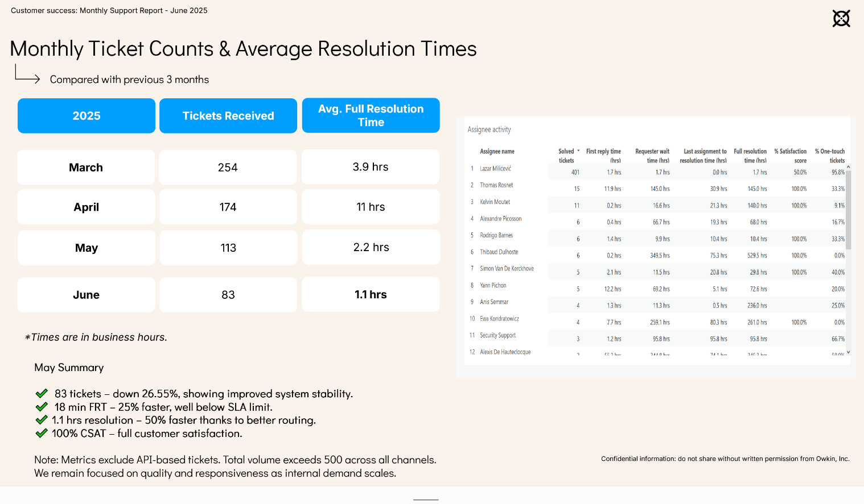
Operational & Reporting Highlights
Customer success: Weekly Support Report – 26.08.2025
Where we are now ?
Zendesk Operations
Rotated agents weekly to maintain consistent coverage across K and Abstra tickets.
SLA target of 2h for First Response Time successfully maintained (avg. under 30 min).
Signup Metrics Automation
K-Nav vs. K-Pro segmentation: Linear issue created for adding a tag to differentiate the two. Jeremy completed the implementation, and the tag will now be used in PostHog to build metrics based on it.
Signup automation: Approval process deprecated → signup is now fully automated.
As a result, the Python script for generating K-Signup reports in Zendesk has been retired.

Slide 4
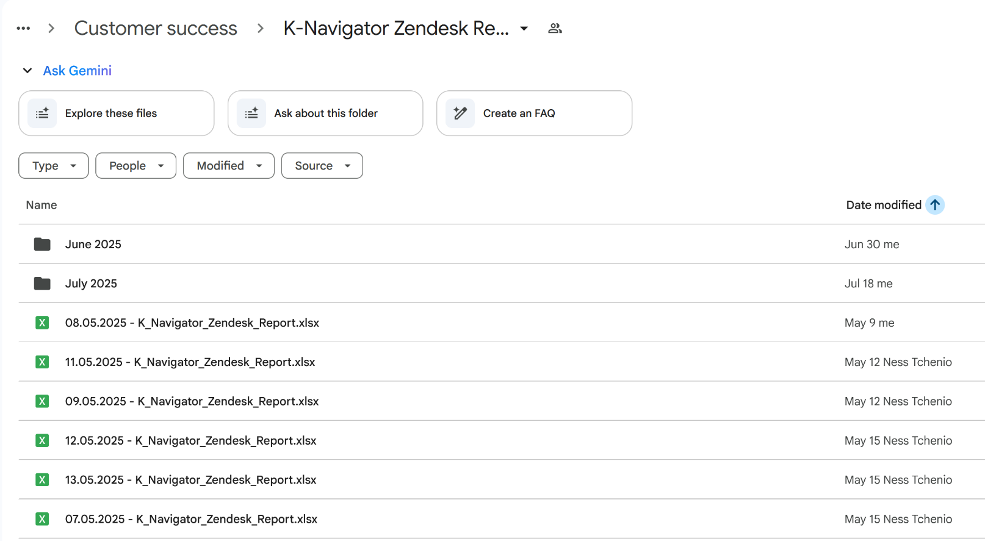
Technical Support & Escalations
Customer success: Weekly Support Report – 26.08.2025
Some of them:
L2 Issue Resolution
Personally resolved VPN setup issues (WireGuard), login problems, and domain whitelisting errors.
Handled edge cases around network connectivity
Optimized triggers & rules in PostHog → duplicate events and inaccurate metrics removed.
Improved onboarding flow → clear tracking of signup vs. confirm events.
Live Support & Onboarding
Conducted live onboarding sessions with external users (Hackathon teams, MOSAIC partners).
Provided real-time support through Slack and Google Meet to ensure smooth environment setup and access flow.

Slide 5

Report Delivery & Ticket Metrics
Customer success: Weekly Support Report – 26.08.2025
Report Sharing & Custom Views
The signup process is now fully automated, and manual approval is no longer required.
The Python script used for generating reports is now deprecated, but before being phased out it produced over 100 custom reports that were used for analysis and supported the Strategy, Product, and Support teams.
Ticket breakdown (Apr–Aug):
K tickets → signup, access, onboarding.
Abstra tickets → infra support, onboarding, troubleshooting.
✅ Automated Slack notifications for new K requests → reduced manual follow-up.
Abstra: Infra support
👉 Monthly Reports Drive

Slide 6
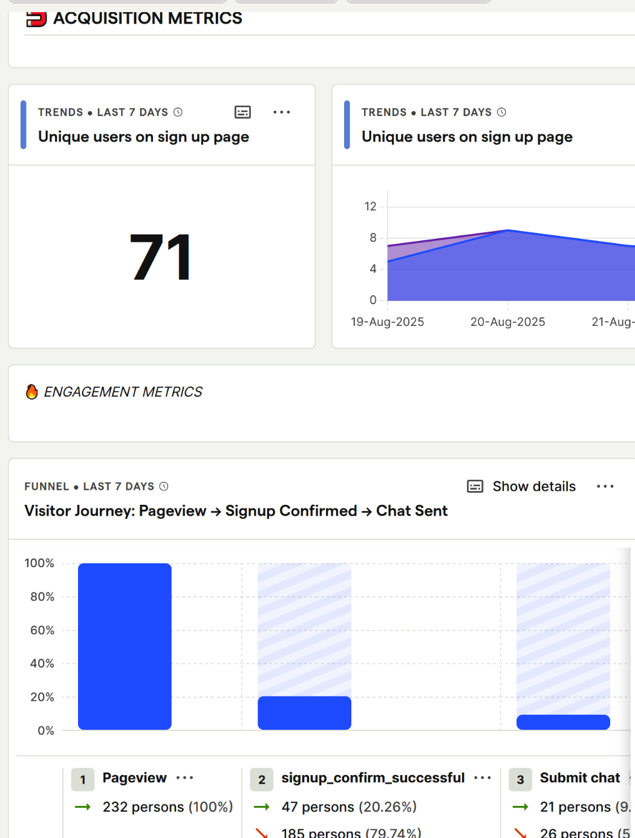
PostHog Integration (Phase 2)
Customer success: Weekly Support Report – 26.08.2025
KPI & Dashboard Progress
20 out of 20 defined KPIs completed and implemented in PostHog.
All tracked events reviewed, mapped, and actively collecting data.
Baseline established: signup funnel, DAU (20–30), retention (5–6%).
Delivery Dashboard: health-check & daily ops.
Strategy Dashboard: long-term trends, retention, funnel analysis.Web vitals (LCP, CLS) baseline defined & anomalies tracked.
📦 FullStory export activated → historical data migration in progress.
Plan to downgrade to Free FullStory account after exports are complete.
Dashboards
Both dashboards live and operational:
  K Delivery Dashboard
  K Strategy Dashboard
Metrics grouped by theme (Acquisition, Engagement, Usage & Technical); charts optimized for clarity and quick insights.
Documentation
Linear project: Analytics, metrics & dashboards
Planning doc: https://www.notion.so/owkin-1/PostHog-Pilot-Plan-Next-2-Weeks-July-22-August-2-2025-2389d6c3b12380adb48bf70d40e2204a
User guide: https://www.notion.so/owkin-1/PostHog-Analytics-User-Guide-2429d6c3b123800aaf81f8e52f9a1c78?source=copy_link

Slide 7
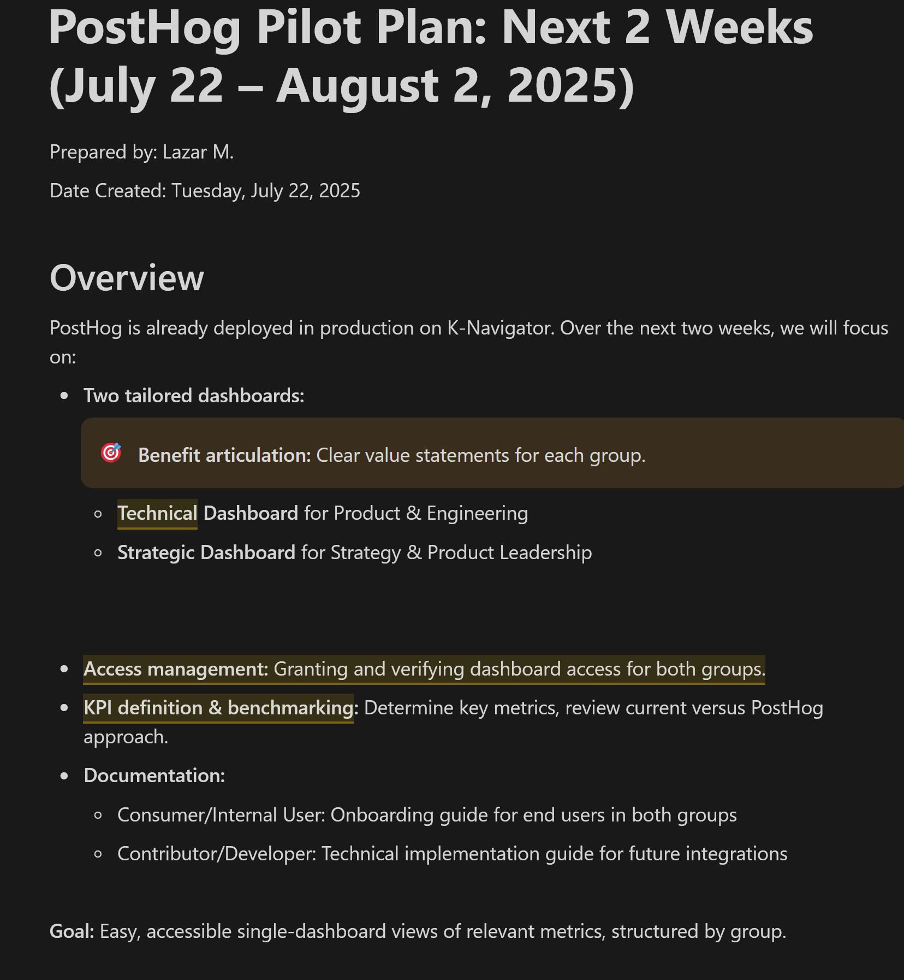
KPIs & Next Steps
Customer success: Weekly Support Report – 26.08.2025
?
Key Outcomes
Stabilized PostHog dashboards (short-term + long-term views).
Refined signup events → clear separation of signup vs. confirm.
Enhanced tracking: clear segmentation between K-Nav and K-Pro users.
Optimized feedback system → faster & more relevant insights.
Impact
More reliable metrics & clearer funnel stages.
Deeper behavioral insights (e.g., first chat).
Reduced manual reporting effort → more automation.
Strong foundation for full transition to PostHog.
Next Steps
Finalize FullStory → PostHog data mapping.
Implement frontend tag for precise segmentation.
Add additional activation & early usage metrics (e.g., first chat event).
Continue optimizing dashboards for PM & CS teams.

Slide 8

Q&A
Customer success: Weekly Support Report – 24.07.2025
?

Slide 9
Thank you!

